Slide 1


Slide 2


Brand Management Associates, Inc.
Harvey Ruttenberg
President
PRIMARY FOCUS
Extending the reach of the world’s greatest BRANDs!

Slide 3
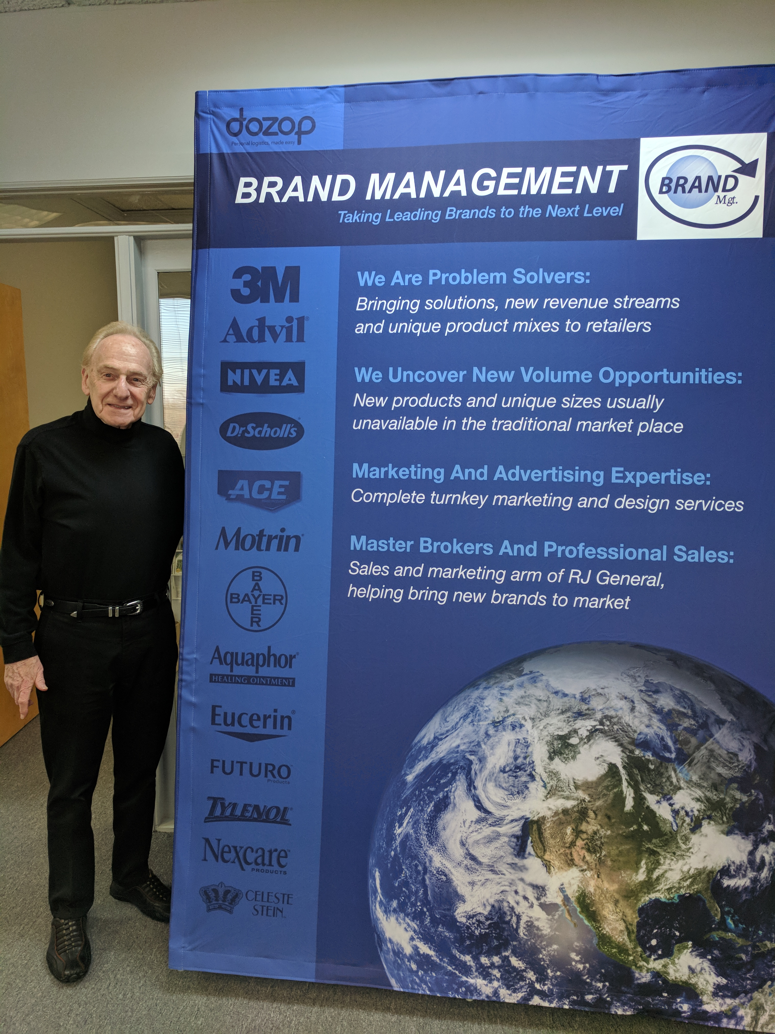
Background
President of Brand Management Associates based in Atlanta, Georgia. Mr. Ruttenberg’s extensive sales, marketing, design, creative and manufacturing experience provided the vision for creating this twenty year old sales and marketing organization.
Owner of 25 year old national sales and marketing organization.
Senior Manager and Advisor for 3M,Pfzier, J&J, Dow Chemical Safety Kleen, Bristol Myers, Bayer, American Home Products, Mondelez, Warner Lambert, Beirsdorf, General Mills, ComplianceCorporation of America, BMW, Mercedes Benz.
Runs a successful multi-faceted enterprise that provides a wide range of creative and focused sales, marketing and business development support to renowned companies throughout the globe.

Slide 4

About us
.
Brand Management is a unique product development and distribution organization. We specialize in the sales, marketing and channel implementation of major branded products to and through non-traditional alternative markets and emerging trade class industries.
Our objective is to identify, develop, design, produce, acquire, market, and distribute your products and services. Our services are tailored to work within the parameters of your budget, work force, product range and corporate vision. We look forward to working with you and your team in extending your reach beyond your expectations.
Brand Management is firmly committed to building the single largest organization specializing in brand development, market transition, and innovative growth opportunities
Our international sales organization consist of Corporate Account Managers and Trade Class Supervisors with offices in the United States, Canada, and Latin America.

Slide 5







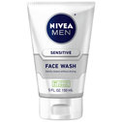
Support
Services
Supervise the work of office, administrative, or customer service employees to ensure adherence to quality standards, deadlines, and proper procedures, correcting errors or problems. With their extensive client list
Provide employees with guidance in handling difficult or complex problems or in resolving escalated complaints or disputes.
Resolve customer complaints or answer customers' questions regarding policies and procedures.
Research, compile, and prepare reports, manuals, correspondence, or other information required by management or Sales Team.

Slide 6
Brand Management Associates, Inc.
Will Humphreys
Director Sourcing and New Product Development

Slide 7
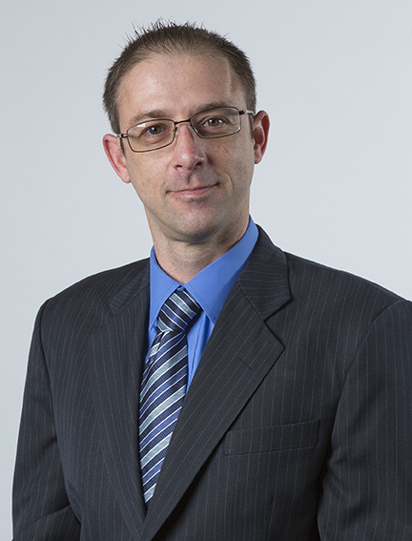
Will’s Background
12 years US Navy Intelligence and Operations
8 years of Category Management and New Product Development
8 years Packaging Manufacturing, Distribution and Logistics
“If you can think it I will find it”

Slide 8



Sourcing and New Product Development
Review current offerings and Identify savings in material, services and operations.
Identify new product categories that provide a value or open up different sales channels for existing products.
Work with sales and marketing for new packaging designs.
Manage international logistics and warehousing to provide a value add/competitive edge vs competition.

Slide 9
Brand Management Associates, Inc.
Craig Thacker
Director of Advertising, Marketing & Design

Slide 10
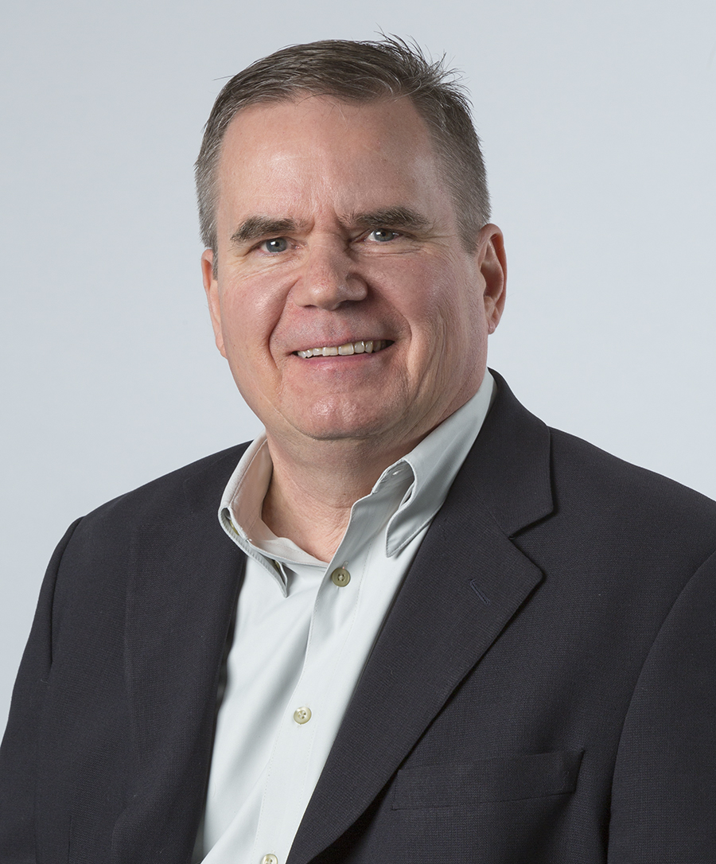
Craig’s Background
Advertising, Design and Marketing
• 20+ years of design agency experience
• Partner and Creative Director,
of Spectrum Design Group for 15 years
• Branding expert with extensive experience
in logos, package design, POP displays,
& marketing collateral

Slide 11
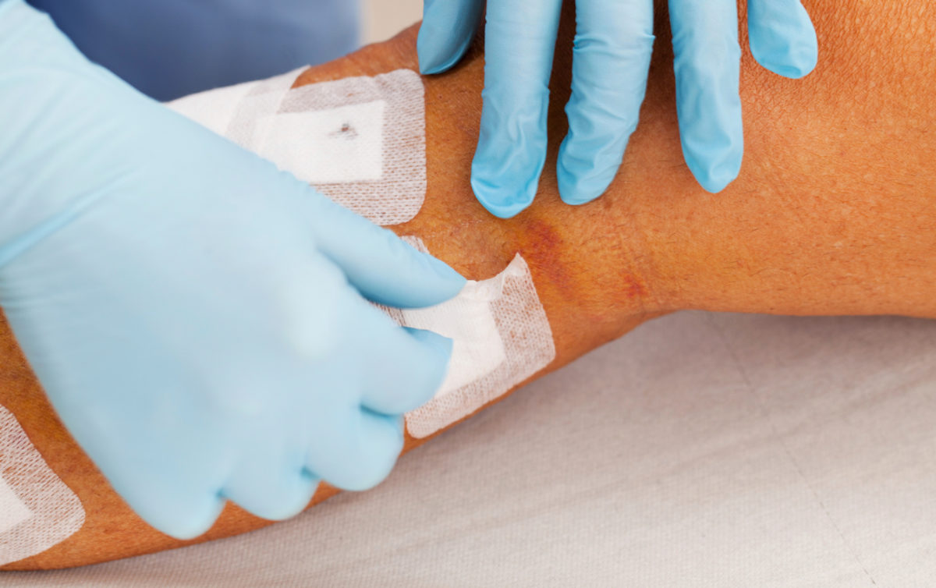
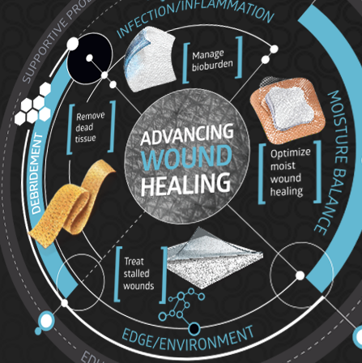
Medline
With over 1500 reps Medline is truly leading the industry in educating their clients with only the best products and innovation.
We’ve committed to Medline that we will continue to update them on Beiersdorf and support their efforts in the field.
For a broad range of skin conditions Medline delivers a complete skincare regimen featuring non-sensitizing formulations by combining the most advanced skincare science with gentle, beneficial botanicals.

Slide 12


Moore Medical
Moore Medical LLC, a subsidiary of McKesson Medical-Surgical, is an Internet-enabled, multi-channel, specialty direct marketer and distributor of medical-surgical supplies, equipment and pharmaceuticals to approximately 120,000 healthcare practices, facilities and organizations in non-hospital settings nationwide. Their customers include: physicians, podiatrists, obstetricians and gynecologists, pediatricians, surgeons, emergency medical technicians, schools, colleges and universities, correctional facilities, municipalities and government agencies, occupational and industrial healthcare professionals and other specialty practice communities..
We service Moore Medical by continued educational calls, meetings and conferences. Committed to their success we will support them on all fronts.
To aid in the care and protection of a patient's skin, Moore Medical offers a variety of products such as creams, ointments, lotions, liquid treatments by brands such as Beiersdorf, DEB/SBS, Fruit of the Earth and more.

Slide 13


PK International
Since 1989 PK International has been a supplier of beauty needs to the multi-cultural market.
With skincare being a top seller for PK International we will continue to service them with education, promotions and field support for their two distribution centers and cash and carry location in Chicago.
PK International is always seeking out the best products and innovations for their clients.

Slide 14
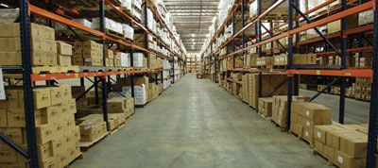

Jinny Beauty Supply
With over 35 years of experience in the beauty industry, Jinny is the price and selection leader. Jinny has the largest selection of multi-cultural & ethnic beauty supplies and general merchandise in the world.
Jinny has been a true backer of Beiersdorf and continue to offer Nivea, Aquaphor and Eucerin as part of their premier skincare lines in their eleven distribution centers.
With quarterly meetings set with Jinny we will continue to support them with all important updates and educational needs.

Slide 15

Special Project

Slide 16
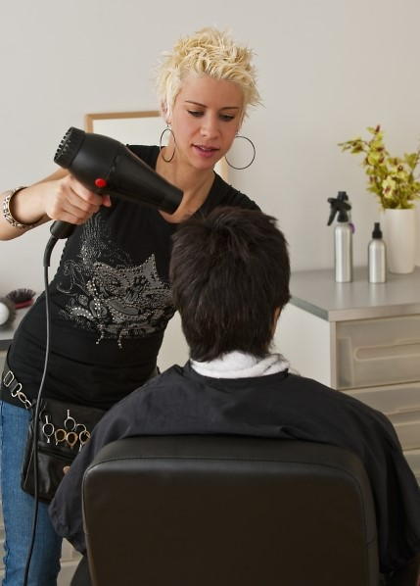
What is SalonCare?
Why SalonCare?
We have designed a program targeted for the salon professionals. Sold into professional salon distributors only.
Here’s what you can find in SalonCare:
AQUAPHOR HEALING OINTMENT
EUCERIN
fUTURO FOR HER KNEE STABALIZER
FUTURO FOR HER ANKLE SUPPORT
FUTURO SPORT COMPRESSION SLEEVES
FUTURO REVITALIZING COMPRESSION LEGWARE
CELESTe STEIN COMPRESSION HOSIERY
Dr. scholl’s inserts
ALOCANE EMERGENCY BURN GEL
Less Down Time = More Revenue
Stylists behind the chair suffer from pain and injuries caused from repetitive movements, work environment and awkward body positioning throughout their long work days.
With this program our intention is to help professionals behind the chair lengthen the time of their careers, take care of their bodies as an athlete.

Slide 17
Brand Management Associates, Inc.
Matthew Diersen
Director of Channel Management & New Business Development
PRIMARY FOCUS
Hardware
Home Centers
Automotive
Specialty Retail
C-Stores
Grocery
Drug
Mass

Slide 18
Background
39 years of Consumer Packaged Goods Industry Experience.
Classically Trained Sales Executive by the Colgate – Palmolive Company.
30+ years experience managing both a Direct and Brokered Sales Force.
  Successfully managed a Brokerage Company from 1989 – 1992.
Have Successfully managed EVERY Class of Trade to positive growth.
  Grocery/Drug/Mass/C-Store and now hardware and other “alternative” distribution channels.
Passion for Innovative products, new ideas and unique items that deliver true points of difference and not just “me too!” benefits.

Slide 19
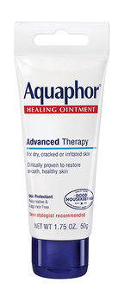

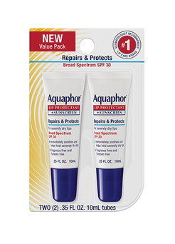
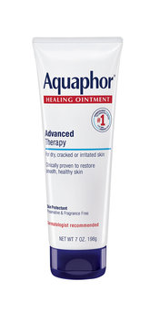
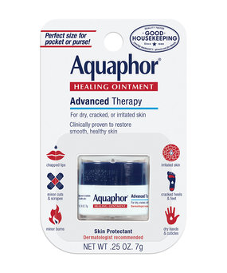
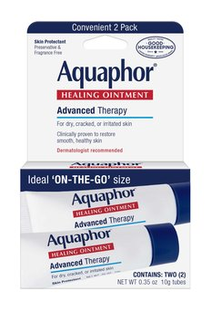
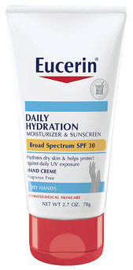
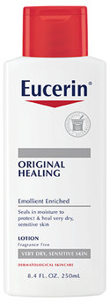
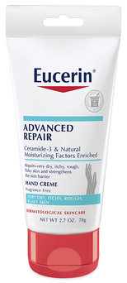
BMA’s
WORK CARE Program
The WORK CARE premise is very simple:
US Dept of Labor Statistics reports that over 27 million non-fatal occupational injuries occurred in 2016.
This totaled over 950,000 LOST DAYS of productivity.
This impacts workers in ALL OCCUPATIONAL CLASSES. White Collar and Blue Collar workers are all impacted.
Everyday people work with some sort of physical discomfort, sore muscles, joints, dry skin, cuts, bruises, you name it!
WORK CARE is designed to be the SINGLE SOURCE for First Aid / Health Care products that people are looking for.
We KNOW that these Consumers are walking into and out of Hardware Stores, Paint Supply Stores, Auto Parts locations, and many other “non-traditional” locations.
They might not be looking at these retailers as the place to buy these types of products, but they are in these locations. We MUST work with these retailers to TEACH, and ENCOURAGE them to have these products available to capitalize on this highly profitable INCREMENTAL sale!
WORK CARE is that ANSWER!

Slide 20
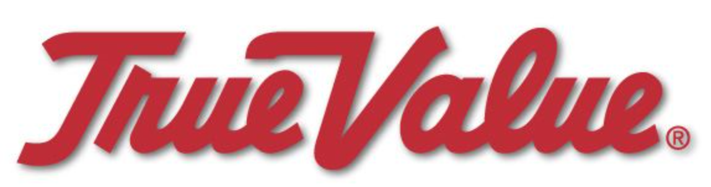
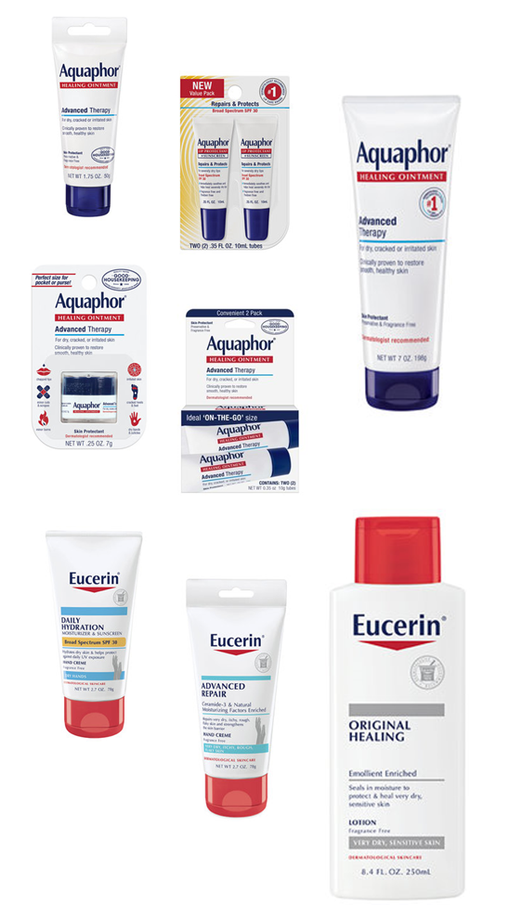
True Value Hardware
Awaiting FINAL approval to move forward with the WORK CARE program.
Once Approval is granted we will begin an aggressive assault targeting the KEY FRANCHISE GROUPS that move the volume needle with True Value.
Continue to work with critical INTERNAL True Value personnel to gain Corporate Support of the program and inclusion in Corporate Marketing events.

Slide 21
Distribution America / DA Online
DA is a Buying Co-Op that includes the following 7 Divisions:
Blish – Mize, Atchison, KS / Florida Hardware, Jacksonville, FL / HDW, Divisional Offices in Texas, LA & MS / House Hasson, Knoxville, TN / Monroe Hardware, Monroe, NC / PACOA, Port Washington, NY / United Hardware, Plymouth, MN / Val – Test Group, Hoffman Estates, IL.
Working with Paul McNally, Merchandising Director, DA Corporate to develop a Plan-O-Gram for implementation in all Divisions. Expect sales presentations to begin in March at each Divisions/Customer. Expect POG to be finalized in early March.
It is important to remember that the bulk of these Distributors sell to groups and independents. We will be working with each Division and their respective sales forces to develop merchandising and marketing plans to ensure maximum distribution.
This will a strong growth account.

Slide 22
Orgill
Privately held, family run corporation.
Operating 7 Distribution Centers and 3 Import/Export facilities across the World.
Fastest growing Hardlines Distributor in the World.
Heavy presence in Canada. Bi-Lingual packaging will be required to ship into Canada.
Attending the February 22 – 24, Dealer Market in Orlando, FL.
Will be introducing our WORK CARE program Orgill’s Dealers at this event.

Slide 23
Mid States Distribution
Participating in the February 15 – 18, Winter Rendezvous Trade Show in Minneapolis, MN.
We are selling our INNOVATIVE
WORK CARE program.
One of Mid States largest customers is Peavey Mart and they are located in Canada.
  We will need Bi-Lingual packaging for this customer.
Store Count is in the neighborhood of 675 locations.
We will begin aggressively closing the Groups in March and April.

Slide 24
MID - STATES
Form

Slide 25
Associate Representatives
Major Accounts
Brand Management has selected a premier group of Special Market
Account Managers to penetrate major accounts for Beiersdorf.
These accounts represent historical gaps in retailing BDF products yet have significant opportunities to extend our overall reach
Major Target Accounts via Special Market Associate Representatives
Bed Bath & Beyond
Cost Plus World Market
Christmas Tree Shops
Hobby Lobby
Kohl’s Department Stores
Lowe’s
Home Depot
Auto Zone
Advance Auto Parts
O’Reillys
Pep Boys
Marc’s Ocean State Odd Lots
TJX Companies / All Divisions
TJ Maxx US & Europe / Marshall’s / Home Goods / Sierra Trade Post
Tuesday Morning
J Polep
C&S Wholesale
Trippi Wholesale
Jetro Cash & Carry / Restaurant Depot
Major Department Stores
Office Product Channel
The listing is long & extensive and continues to grow helping us to expand our reach.

Slide 26
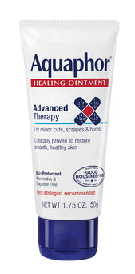

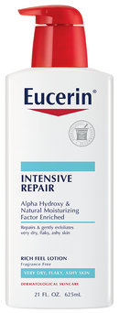

TriMark
Restaurant Equipment
Creating a WorkCare program directed towards the Foodservice market.
Foodservice workers expose their skin to several chemicals/sanitizers that dry out hands, arms, etc.
There is a demand for products to alleviate skin conditions derived from working in a Foodservice environment.
TriMark is one of the 5 largest distributors of foodservice equipment in the country.

Slide 27
RaceTrac
Fuel Stations
Over 600 locations
These products would be an add on to someone's purchase
Convenient one stop shopping
Huge opportunity with placement

Slide 28
Diaz Foods
Specialty Food Distributor
Leading distributor & marketer of specialty foods
The WorkCare program would allow new sales to their existing customer base
Foodservice workers expose their skin to several chemicals/sanitizers that dry out hands, arms, etc.
There is a demand for products to alleviate skin conditions derived from working in a Foodservice environment.

Slide 29
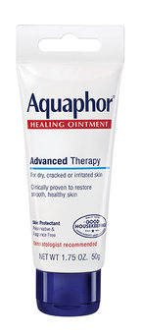

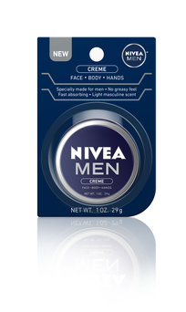
College Campus
GA State, GA Tech, Kennesaw State
Placing these items on campus would be a big win
Lotions and skincare are used by both traditional and non-traditional students/faculty
GA State and Kennesaw State are 2 of the largest colleges in the state

Slide 30
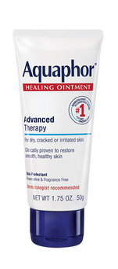
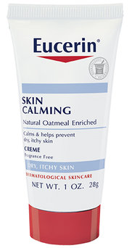
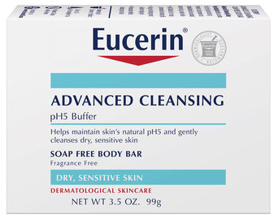
Imperial Dade
Disposable & Chemical Distributor
They distribute to schools, restaurants and business offices
They now have a cruise ship side of their business
With the growing knowledge and need for these products, this is a perfect fit

Slide 31
TriMark
Restaurant Equipment
Creating a WorkCare program directed towards the Foodservice market.
Foodservice workers expose their skin to several chemicals/sanitizers that dry out hands, arms, etc.
There is a demand for products to alleviate skin conditions derived from working in a Foodservice environment.
TriMark is among the first to have an interest in a program targeting these consumers.

Slide 32
Southern Refreshments
Micro Market
Micro Markets are emerging as one of the fastest growing segments in Foodservice and Healthcare.
Lotions and skincare are among the most requested items that do not currently exist in the micro market segment.
Southern Refreshments, one of the largest distributors in the Southeast, has signed on to begin a program.

Slide 33
New Project
Tattoo Aftercare Kit
Aquaphor and Eucerin are THE most recommended items for Tattoo Aftercare.
45 million people have at least one tattoo.
Tattooing continues to be a growing industry.
Demands for a complete aftercare kit are high.

Slide 34
Brand Management Associates, Inc.
Jerry Waite
Medical Account Manager

Slide 35
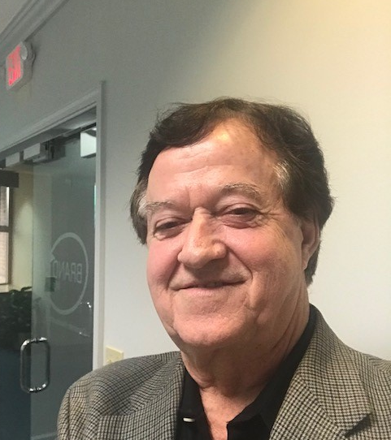
Jerry’s Background
25 + years in Medical field w/ distributors & manufacturers, Major hospitals, clinics and government accounts
Lead development& expansion in the southeast for medical supply & sales.
Specialized in new product introduction & expansion
Worked with local & regional medical distributors in training and sales development

Slide 36
Brand Management Associates, Inc.
Solly Khadoury
Director of National Accounts, Healthcare, E-Commerce, B2B, North America Special Accounts

Slide 37
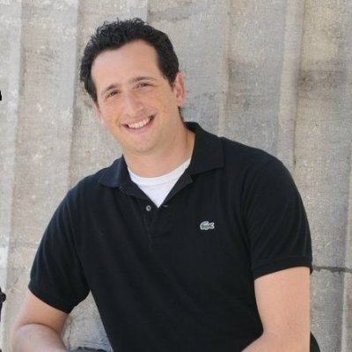
Background
10 years Health & Beauty sales and sales management
Proven track record of consistent sales in excess of $10M/year
Driven by quality and superior customer service
Extensive experience working with National Retailers

Slide 38
Bilo Limited
Beauty Supply Distributors
Distributing Aquaphor, Eucerin, Nivea items to beauty boutiques in North Eastern US.
Beauty boutiques and Salons well aware of the importance of quality, and skin hydration.
Bilo Ltd. Services over 5,000 accounts including drug chains , independent pharmacies, variety/discount drug stores, beauty supply and convenience stores.

Slide 39
OpenTip
E-Commerce Retailer
OpenTip offers premium quality products with competitive pricing, broad selection, excellent services and secure shopping.
They carry over 10,000 brands of products across mixed categories- sporting goods, wedding supplies, office, home and garden, toys, gifts and promotional items.
Always searching for brands that represent the highest quality standards, they purchase in large volumes in order to take advantage of economies of scale- passing the savings over to their customers.

Slide 40
Total Source Network
E-Commerce Retailer
Total Source Network actively manages brands across leading E-Commerce platforms- Amazon, eBay, Sears, Rakuten
They also manage their own E-Commerce retail sites, to maximize on their margins.
With over 40,000 Facebook fans, they have active eyes on our products, which they work to convert into sales.

